Slide 1
MICRO CREDIT DEFAULTER PREDICTION USING MACHINE LEARNING
-Yash Bhardwaj

Slide 2
Outline
Introduction
Dataset Information
Data Pre-processing and Visualization
Building Models
Conclusion

Slide 3
Introduction
Microcredit is an extremely small loan given to those who lack a steady source of income, collateral. It is used as a way to obtain a loan, acting as a protection against potential loss for the lender should the borrower default in his payments., or any credit history.
Problem Statement
- We have to build a machine learning model which can predict the defaulter customer.

Slide 4
Dataset Information
Dataset provide by Fliprobo Technologies Ltd.
Micro Credit Defaulter dataset contain 209593 rows and 37 columns.
Out of all features only three features with object datatypes and rest are int64.
Data integrity check is perform for missing values, duplicate data, data error.
No missing values, whitespaces, ‘NA’, ‘-’ are present in dataset.

Slide 5
Data Pre-Processing and Visualization
Data error and correction in maxamnt_loans30 column
The maximum value in maxamnt_loans30 is not reliable.
Assumption - The maximum value in maxamnt_loans30 is 12.
Corrective Action - Replacing values greater than 12 into category of zero.
Dropping Unnecessary columns

Slide 6
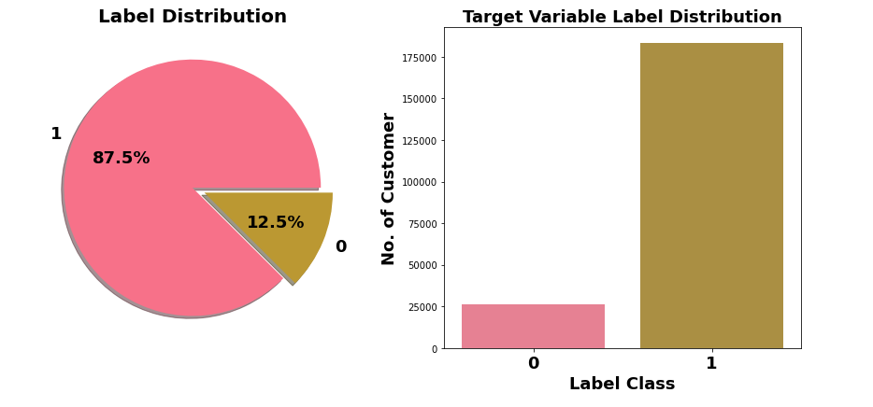
Observation:
Label class 1 represent non-defaulter while Label class 0 represent defaulter
Only 12.5% customers are defaulters.
Target Variable Label is imbalanced in nature.

Slide 7
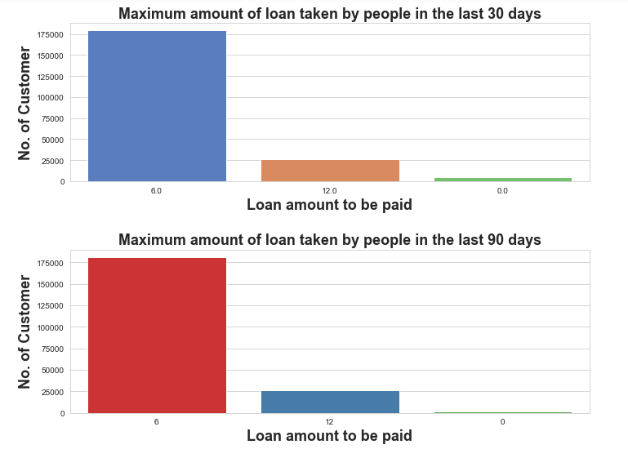
Observations: - In 30 & 90 days, maximum number of people had taken 6Rs as the loan amount. - Customers have less tendency to take loan in amount of 12. - There are very few people who do not taken loan.

Slide 8
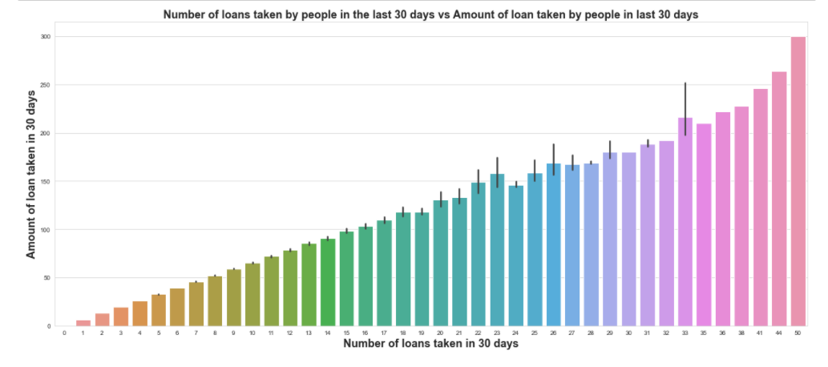
Observation:
- Maximum number of times loans taken by the people is 50 and the Average loan amount is equivalent to 300

Slide 9
Building Models
Before applying the algorithms data encoding has to be done for categorical data.
The different classification algorithm used in this project to build ML model are as below:
- Logistic Regression
- Decision Tree Classifier
- Random Forest Classifier

Slide 10
Conclusion:
Objective is to predict customer is defaulter or not. It can be solve by application of classification ML algorithm.
Different Classification algorithm used to train model, in order to have maximum accuracy score.
Limited computational resources put limitation on optimization through hyper parameter tuning. Accuracy of model can increase with hyperparameter tuning with several different parameter. Here we use only two parameters for tuning.
Data is imbalanced, we utilised SMOTE for it but if get label data which at least in ratio of 70:30, It can give us much more realistic model.

